Slide 1
프로젝트 : 이미지 변환 ( 선명도 증가 )
사용 라이브러리 : numpy, matplotlib.pyplot, time
2020192046 허민혁

Slide 2
흑백변환 (Decolor)
##d_Image = np.zeros_like(image) + np.sum(image, axis=2) / 3 ## broadcasting rule d_Image = np.zeros_like(image) image_sum = np.sum(image, axis=2) // 3 for i in range(3) : d_Image[:,:,i] = image_sum
Broadcasting rule :
두 배열의 각 축에 대해
한쪽의 축의 길이가 1
축의 길이가 동일
이때 축의 비교는 뒤에서부터 하나씩 진행된다.

Slide 3
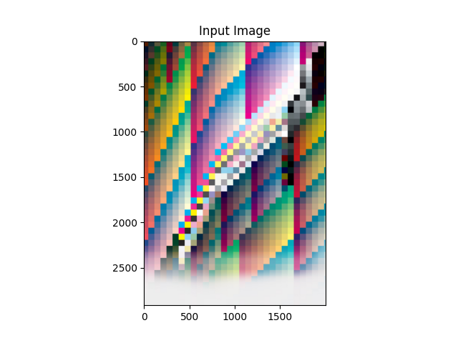
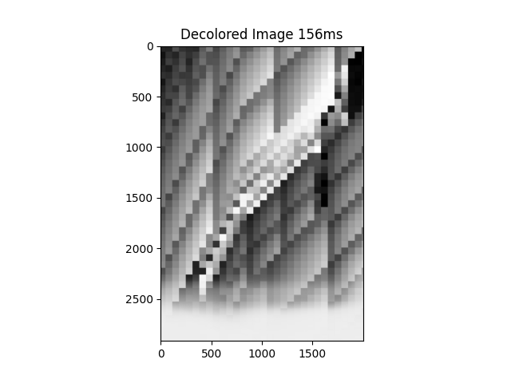
흑백변환 (Decolor)

Slide 4
Trial 1
def hLinTrans(n, image): ## 가로 방향 선형 변환 row = np.shape(image)[0] column = np.shape(image)[1] hor = column mImage = np.zeros_like(image) hLinTrans_diag = np.eye(hor) * (1 + n) / 2 mask = np.arange(hor).reshape((1, hor)) - np.arange(hor).reshape((hor, 1)) hLinTrans_next = (np.abs(mask) == 1).astype(np.uint8) * (1 - n) / 4 hLinTrans_next[1, 0] = (1 - n) / 2 hLinTrans_next[hor - 2, hor - 1] = (1 - n) / 2 hLinTrans_matrix = hLinTrans_diag + hLinTrans_next ## 변환 행렬 생성 for i in range(3): mImage[:, :, i] = np.dot(np.reshape(image[:, :, i], (row, column)), hLinTrans_matrix) ## 선형 변환 return mImage def vLinTrans(n, image): ## 세로 방향 선형 변환 행렬 생성 row = np.shape(image)[0] column = np.shape(image)[1] ver = row mImage = np.zeros_like(image) vLinTrans_diag = np.eye(ver) * (1 + n) / 2 mask = np.arange(ver).reshape((1, ver)) - np.arange(ver).reshape((ver, 1)) vLinTrans_next = (np.abs(mask) == 1).astype(np.uint8) * (1 - n) / 4 vLinTrans_next[ver - 1, ver - 2] = (1 - n) / 2 vLinTrans_next[0, 1] = (1 - n) / 2 vLinTrans_matrix = vLinTrans_diag + vLinTrans_next ## 변환 행렬 생성 for i in range(3): mImage[:, :, i] = np.dot(vLinTrans_matrix, np.reshape(image[:, :, i], (row, column))) ## 선형 변환 return mImage def diff_Amplification4(image) : amp_constant = 1 amp_image = hLinTrans(amp_constant, image) / 2 + vLinTrans(amp_constant, image) / 2 return amp_image.astype(eval("np."+image.dtype.name))
RGB 값

Slide 5

Trial 1

Slide 6
Process 1.
def diff_Amplification1(image) : boundary_constant = 1 image_mean = np.mean(image) boundary_halfsize = boundary_constant * np.std(image) high_noise = image_mean + boundary_halfsize low_noise = image_mean - boundary_halfsize mask_high = image > high_noise mask_low = image < low_noise high_bound = 255 low_bound = 0 amp_image = ((image-low_noise)*(high_bound-low_bound)/2/boundary_halfsize+low_bound).astype(np.uint8) ## 분포 영역 변환 amp_image[mask_high] = 255 amp_image[mask_low] = 0 return amp_image

Slide 7
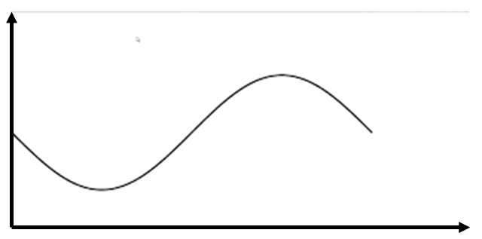


Process 1.
$±$std
픽셀수
mean
RGB

Slide 8
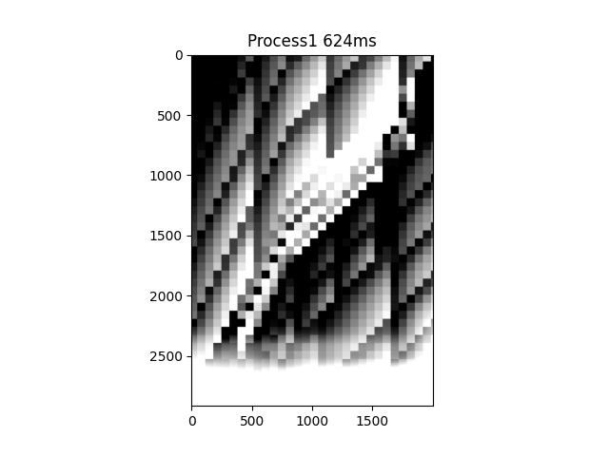
Process 1

Slide 9
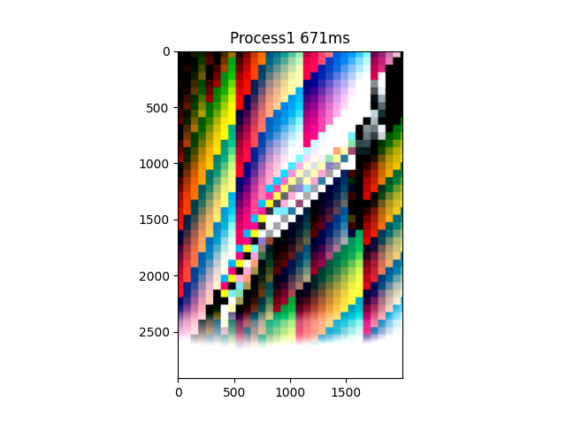
Process 1

Slide 10
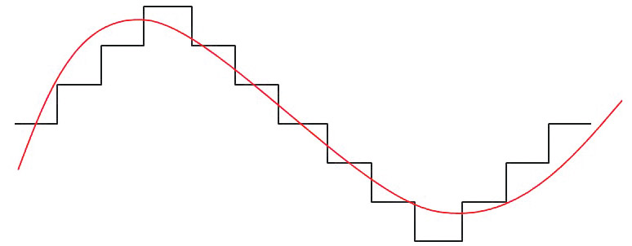
Process 2.
def diff_Amplification2(image) : color_width = 10 amp_image = image/color_width*color_width return amp_image.astype(eval("np."+image.dtype.name))

Slide 11

Process 2

Slide 12
Process 3.
def diff_Amplification3(image) : amp_image = image.copy() boundary_constant = 1 image_mean = np.mean(image) boundary_halfsize = boundary_constant * np.std(image) high_noise = image_mean + boundary_halfsize low_noise = image_mean - boundary_halfsize mask_high = image > high_noise mask_low = image < low_noise high_bound = 255 low_bound = 0 amp_image[mask_high] = 255 amp_image[mask_low] = 0 pix_per_RGB = np.size(image[(image >= low_noise)&(image <= high_noise)])//(high_bound - low_bound) count = 0 for i in range(int(low_noise), int(high_noise+1)) : amp_image[image == i] = count//pix_per_RGB count += np.size(image[image == i]) return amp_image

Slide 13
Process 3.
픽셀수
RGB
픽셀수
RGB
Notes:
Process 1의 문제점 : 늘려봤자 케이스 따라 늘어나는 정도가 다르고 효과가 미미한 경우도 있다. 뭉친데를 늘려봐야 뭉쳐있다

Slide 14
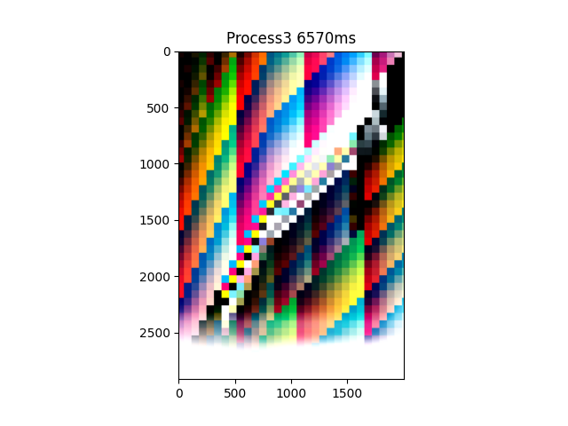
Process 3

Slide 15
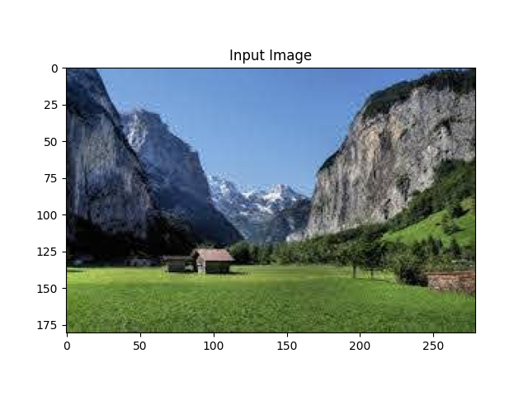


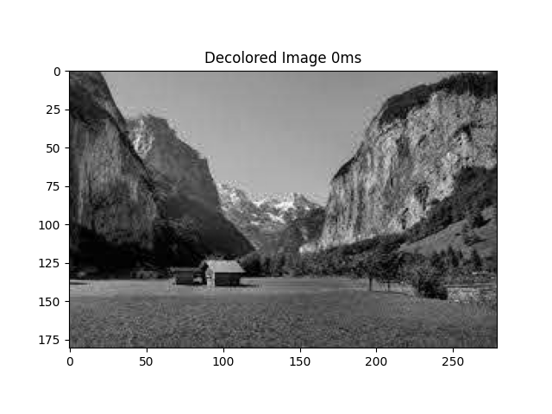
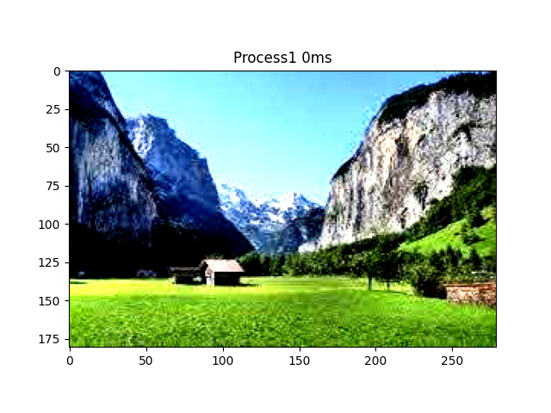
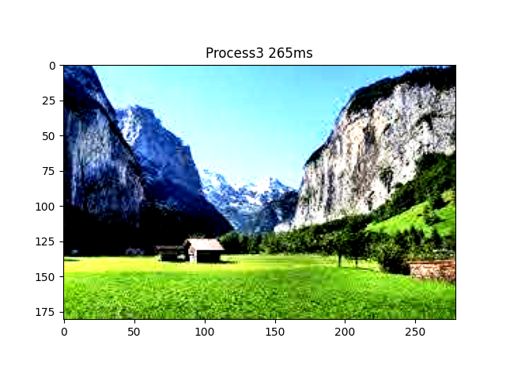

Slide 16
